Slide 1


The Building Safety Manager: role, competences and certification
12pm, Wednesday 3 February 2021

Slide 2
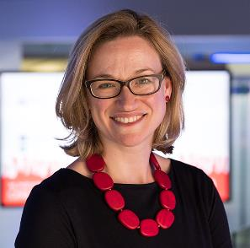
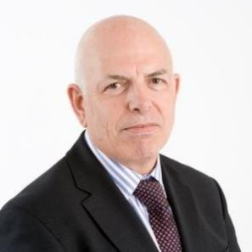
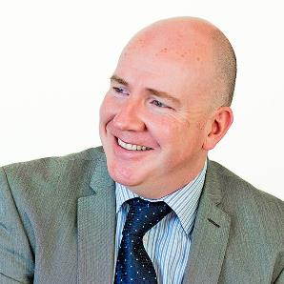
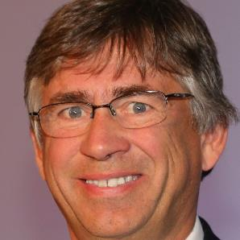
Panellists
Sofie Hooper,
Head of Policy, IWFM
Life Safety Working Group and WG8 Secretariat
Rob Greenfield, Director ASR Management; IWFM Life Safety Working Group and WG8 participant
Wayne Ward,
Regeneration Programme Manager,
Curo Homes Ltd,
IWFM Life Safety Working Group
Mark Snelling,
health, safety and fire adviser to ARMA; WG8 participant
Notes:
Dave Cooke
Dave Cooke is an independent consultant specialising in resilience, business continuity and crisis management and he chairs the IWFM Risk and Business Continuity SIG.
Dave spent over 30 years working for the BBC’s International News Division and headed their Facilities Management function before specialising in security, business continuity and risk management. He was head of Business Continuity and Risk Management for BBC Global news with responsibilities for maintaining staff safety and programme output in their multi-media news operations in the UK and 90 countries around the world.
More recently Dave has been working with clients across industry sectors to help them responded effectively to the Coronavirus pandemic and adapt their continuity plans to meet the current challenges.
Dave is a Fellow of the IWFM, a member of the Business Continuity Institute and holds Board certifications in Business Continuity and Security. Dave is also a member of the British Standard Institute’s Continuity and Resilience Committee and Board member of the UK Security Commonwealth.
Jon Newson
Jon has worked both in the UK and internationally, as a change manager, bringing about smooth transitions through effective communication and stakeholder engagement for facilities organisations. As deputy chair of the IWFM Risk Management and Business Continuity Special Interest Group, he co-authored the new IWFM Good Practice Guide for Risk Management. Jon’s client list over his 25 years facilities experience includes Macro, RBS, HMRC, EY, Sainsburys, 2012 CLM, Emaar (Dubai) and Digiplex (Scandinavia).
Jon recently worked with Oxfordshire County Council to successfully recover and redesign a facilities engineering and maintenance service, changing from an outsourced model to a self-delivery organisation, on the collapse of Carillion. Recruiting, building processes and delivering transition within a two-week time frame to support business continuity for Oxfordshire County Council services, including implementation of a CAFM system as a reactive service initially within two days.
Currently he is applying his experience and thinking to the effects of the covid-19 pandemic and the challenges facing organisations, including the recovery phase.
Sofie Hooper
Sofie leads on the IWFM’s wider policy and public affairs work, helping to raise the voice of the Institute, its members and the wider workplace and facilities management sector. She translates best practice into policy objectives and engages with stakeholders to ensure best practice is taken on board and any concerns affecting workplace and facilities professionals are mitigated.

Slide 3
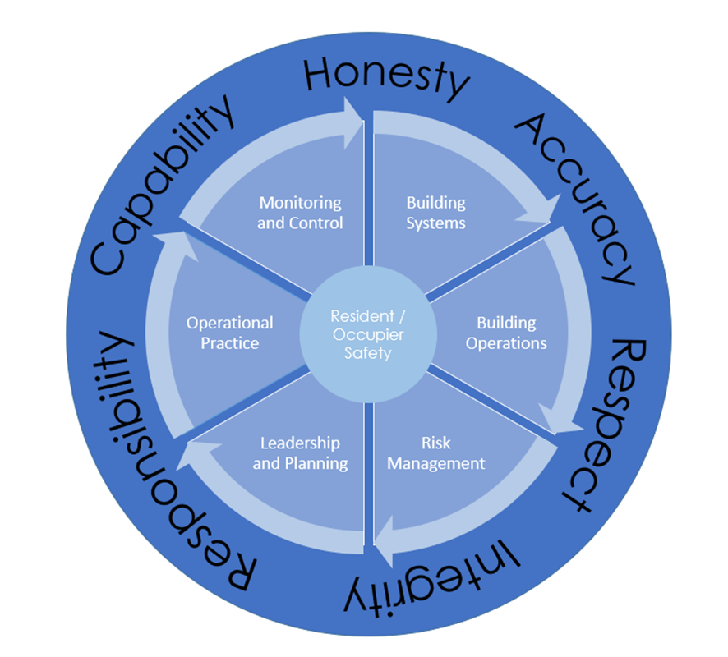
BSM competences or SKEB – WG8
Setting the bar and Safer people, safer homes: Building Safety Management published on 5th October
PAS and statutory guidance (clause 101 draft Building Safety Bill)
BSI Flex 8670 consultation until 2 February

Slide 4


Your questions

Slide 5
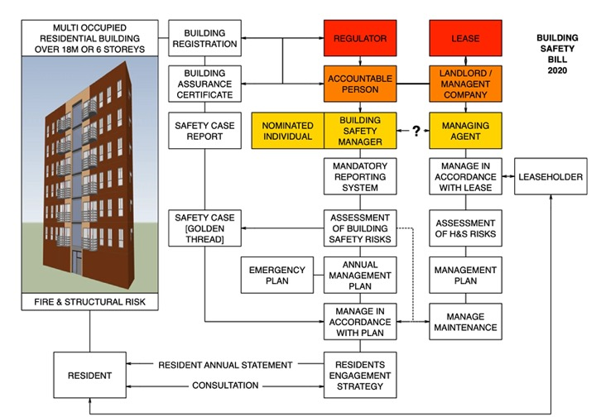


Slide 7


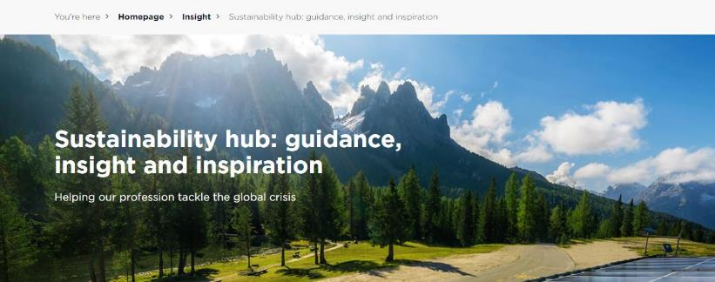
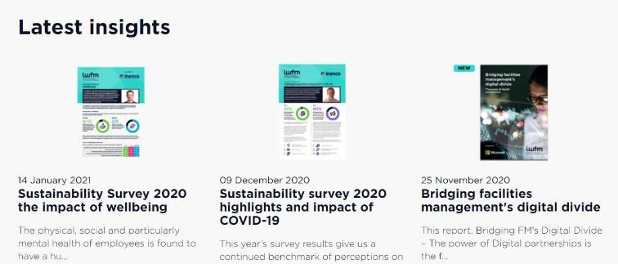
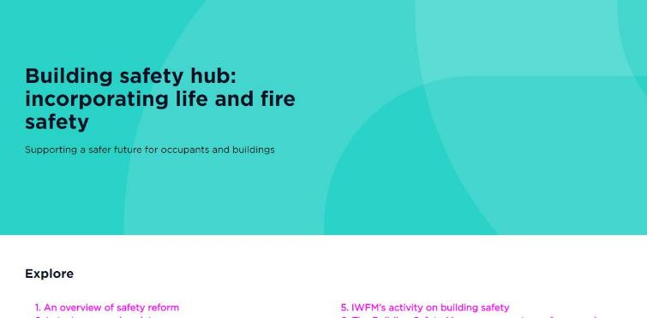
Insight hub
Dedicated content hubs
Research reports
Good practice guides
Guidance notes
And more…
Available to download at iwfm.org.uk/insight

Slide 8

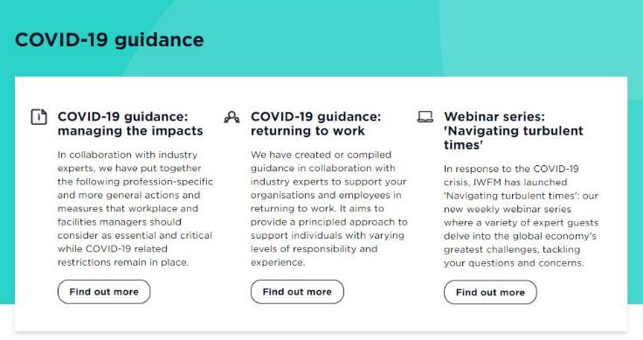
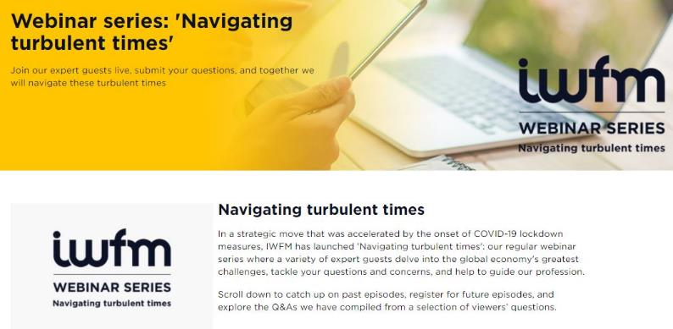
COVID-19 resources
We have created three resources in collaboration with industry experts to support the profession through these challenging times –
COVID-19 guidance: managing the impacts;
COVID-19 guidance: returning to work
Webinar series: 'Navigating turbulent times'.
iwfm.org.uk/coronavirus-resources

Slide 9

Market Outlook Survey 2021
The impacts of the past year will change how we live and work in 2021 and beyond.
Please take a moment to complete the survey and help us to:
build a comprehensive picture of how the UK FM market has performed over the last year
how it may perform over the next 12 months
and the factors that are affecting it.
https://www.iwfm.org.uk/resource/complete-the-iwfm-market-outlook-survey-2021.html

Slide 10
To ask a question or share your case studies and best practice with us, please email:
policy@iwfm.org.uk

Slide 11

iwfm.org.uk/coronavirus-resources.html

